Slide 1
Async Await in Python

Slide 2
Task - 1
Async Await in Python

Slide 3
Parallelising the execution of coroutines
Async Await in Python
Task - 1

Slide 4
Modules Used:
1.aiohttp: Used to make asynchronous HTTP requests.
2.asyncio: Used for managing asynchronous Tasks
3.time: Used to measure execution Time
Async Await in Python
Task - 1

Slide 5
import aiohttp
import asyncio
import time
Async Await in Python
Task - 1

Slide 6
Next we define the download_page coroutine that takes a page parameter which represents the page number to download.
Async Await in Python
Task - 1

Slide 7
async def download_page(page):
Async Await in Python
Task - 1

Slide 8
async def download_page(page):
url = f"https://reqres.in/api/users?page={page}"
Async Await in Python
Task - 1

Slide 9
We also use aiohttp to create a ClientSession which makes a get request to the specified url and awaits the response using await response.text()
Async Await in Python
Task - 1

Slide 10
async with aiohttp.ClientSession() as session:
async with session.get(url) as response:
await response.text()
Async Await in Python
Task - 1

Slide 11
async def download_page(page):
url = f"https://reqres.in/api/users?page={page}"
async with aiohttp.ClientSession() as session:
async with session.get(url) as response:
await response.text()
Async Await in Python
Task - 1

Slide 12
Next we define the main coroutine which is the entry point of our program.
We start by defining an array arr with the page numbers we want to download as the elements.
Async Await in Python
Task - 1

Slide 13
async def main():
arr = [1, 2, 3]
Async Await in Python
Task - 1

Slide 14
Then we create a list of tasks such that each task is downloading a page using the download_page
coroutine with page number from the array arr.
Async Await in Python
Task - 1

Slide 15
tasks = [download_page(el) for el in arr]
Async Await in Python
Task - 1

Slide 16
async def main():
arr = [1, 2, 3]
tasks = [download_page(el) for el in arr]
Async Await in Python
Task - 1

Slide 17
We record the start time using time.time.
Async Await in Python
Task - 1

Slide 18
start = time.time()
Async Await in Python
Task - 1

Slide 19
The asyncio.gather() is used to execute all the tasks concurrently. The *tasks notation is used to unpack the tasks from the list and pass them as seperate arguments to asyncio.gather()
Async Await in Python
Task - 1

Slide 20
await asyncio.gather(*tasks)
Async Await in Python
Task - 1

Slide 21
Once all tasks are completed, we calculate time elapsed by subtracting the current time from the start time and print it.
Async Await in Python
Task - 1

Slide 22
time_taken = time.time() - start
print(f"Time Taken: {time_taken}")
Async Await in Python
Task - 1

Slide 23
async def main():
arr = [1, 2, 3]
tasks = [download_page(el) for el in arr]
start = time.time()
await asyncio.gather(*tasks)
time_taken = time.time() - start
print(f"Time Taken: {time_taken}")
Async Await in Python
Task - 1

Slide 24
Finally we run the main coroutine using asyncio.run().
This function creates an event loop, executes the coroutine and stops the event loop when the coroutine is complete.
Async Await in Python
Task - 1

Slide 25
asyncio.run(main())
Async Await in Python
Task - 1

Slide 26
Sample Output:
Time Taken: 0.3954508304595947
NOTE:
The execution time of an aiohttp application can vary each time you execute it due to several factors such as Network Latency, Server Load and application complexity.
Async Await in Python
Task - 1

Slide 27
Task - 2
Async Await in Python

Slide 28
Downloading JSON files for a URL synchronously
Async Await in Python
Task - 2

Slide 29
import requests
import time
Async Await in Python
Task - 2

Slide 30
import requests: The script starts by importing the requests module, which allows us to make HTTP requests easily.
import time: The time module is imported to measure the execution time.
Async Await in Python
Task - 2

Slide 31
start_time = time.time()
Async Await in Python
Task - 2

Slide 32
start_time = time.time(): The current time is recorded as the start time.
Async Await in Python
Task - 2

Slide 33
for comic_id in range(1, 201):
Async Await in Python
Task - 2

Slide 34
for comic_id in range(1, 201): This loop iterates over the range of comic IDs from 1 to 200 (inclusive).
Async Await in Python
Task - 2

Slide 35
url = f"https://xkcd.com/{comic_id}/info.0.json"
response = requests.get(url)
Async Await in Python
Task - 2

Slide 36
url = fhttps://xkcd.com/{comic_id}/info.0.json :The URL is constructed dynamically using the comic ID from the loop.
response = requests.get(url) :The script makes a GET request to the constructed URL using requests.get() and stores the response in the response variable.
Async Await in Python
Task - 2

Slide 37
for comic_id in range(1, 201):
url = f"https://xkcd.com/{comic_id}/info.0.json"
response = requests.get(url)
Async Await in Python
Task - 2

Slide 38
if response.status_code == 200:
json_data = response.json()
file_name = f"comic_{comic_id}.json"
Async Await in Python
Task - 2

Slide 39
if response.status_code == 200: : Checks if the response status code is 200, indicating a successful request.
json_data = response.json() :The response content is parsed as JSON using response.json() and stored in the json_data variable.
file_name = f"comic_{comic_id}.json" :The file name is created based on the comic ID.
Async Await in Python
Task - 2

Slide 40
with open(file_name, "w") as file:
file.write(response.text)
print(f"Downloaded and saved JSON for comic {comic_id} to {file_name}")
Async Await in Python
Task - 2

Slide 41
with open(file_name, "w") as file: : Opens the file in write mode, using a with statement to ensure proper file handling.
file.write(response.text) : The JSON response text is written to the file.
print(f"Downloaded and saved JSON for comic {comic_id} to {file_name}") :Prints a success message indicating that the JSON for the comic has been downloaded and saved.
Async Await in Python
Task - 2

Slide 42
else:
print(f"Failed to download JSON for comic {comic_id}")
Async Await in Python
Task - 2

Slide 43
else: If the response status code is not 200, indicating an unsuccessful request, it prints a failure message.
Async Await in Python
Task - 2

Slide 44
end_time = time.time()
execution_time = end_time - start_time
print(f"Execution Time: {execution_time} seconds")
Async Await in Python
Task - 2

Slide 45
end_time = time.time(): The current time is recorded as the end time.
execution_time = end_time - start_time : The execution time is calculated by subtracting the start time from the end time.
print(f"Execution Time: {execution_time} seconds") :Prints the execution time in seconds.
Async Await in Python
Task - 2

Slide 46
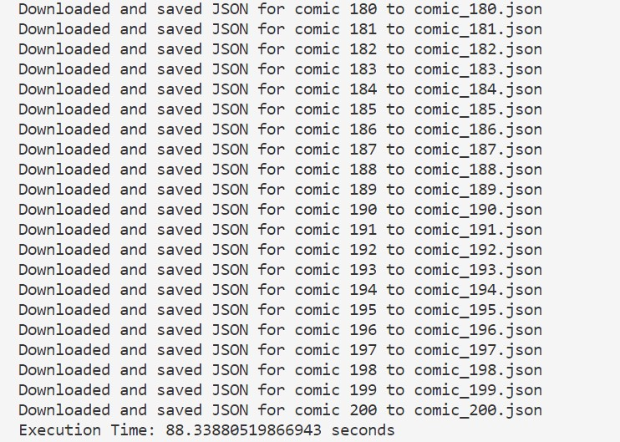
Sample Output:
…
Async Await in Python
Task - 2

Slide 47
Task - 3
Async Await in Python

Slide 48
Parallelising the execution of Files
Async Await in Python
Task - 3

Slide 49
The code for Task 3 does the same functionality as Task 2, but this does it asynchronously which also implies lesser execution time.
The code starts by importing the required modules:
aiohttp :
Used to make asynchronous HTTP requests.
asyncio :
Used for managing coroutines and tasks.
time :
Used for measuring the execution time.
Async Await in Python
Task - 3

Slide 50
import aiohttp
import asyncio
import time
Async Await in Python
Task - 3

Slide 51
Next we define the download_file coroutine which takes a session parameter representing the aiohttp client session and a comic_id parameter representing the id of the comic to download.
The url variable constructs the url dynamically based on the comic_id. Then we use session.get(url) to make an asynchronous GET request to the specified URL. We then await the response using async with session.get(url) as response.
Async Await in Python
Task - 3

Slide 52
async def download_file(session, comic_id):
url = f"https://xkcd.com/{comic_id}/info.0.json"
async with session.get(url) as response:
Async Await in Python
Task - 3

Slide 53
If the response.status is 200 (indicating a successful request), it extracts the JSON content using await response.text() and saves it to a file with a unique name (comic_{comic_id}.json).
It then prints a success message indicating the download and saving of the JSON file. If the response status is not 200, it prints a failure message
Async Await in Python
Task - 3

Slide 54
if response.status == 200:
file_name = f"comic_{comic_id}.json"
content = await response.text()
with open(file_name, "w") as file:
file.write(content)
print(f"Downloaded and saved JSON for comic {comic_id} to {file_name}")
else:
print(f"Failed to download JSON for comic {comic_id}")
Async Await in Python
Task - 3

Slide 55
The main coroutine is the entry point of our program. It starts by creating an aiohttp client session using async with aiohttp.ClientSession() as session.
The async with statement ensures that the session is properly closed after execution.
Async Await in Python
Task - 3

Slide 56
async def main():
async with aiohttp.ClientSession() as session:
Async Await in Python
Task - 3

Slide 57
A list tasks is created to store the coroutines for parallel execution. Inside a for loop, for each comic ID in the range of 1 to 200, it appends the download_file coroutine (awaitable) with the current session and comic_id to the tasks list.
Async Await in Python
Task - 3

Slide 58
tasks = []
for comic_id in range(1, 201):
tasks.append(download_file(session, comic_id))
Async Await in Python
Task - 3

Slide 59
After creating all the tasks, it records the start time using time.time(). Then, it uses asyncio.gather() to concurrently execute all the tasks.
The *tasks notation is used to unpack the tasks from the list and pass them as separate arguments to asyncio.gather. This allows the tasks to run in parallel, accelerating the execution.
Async Await in Python
Task - 3

Slide 60
start_time = time.time()
await asyncio.gather(*tasks)
Async Await in Python
Task - 3

Slide 61
Once all the tasks are completed, it records the end time using time.time()
The difference between the end time and the start time gives the execution time in seconds, which is calculated and assigned to the execution_time variable.
Finally, it prints the execution time.
Async Await in Python
Task - 3

Slide 62
end_time = time.time()
execution_time = end_time - start_time
print(f"Execution Time: {execution_time} seconds")
Async Await in Python
Task - 3

Slide 63
The code uses asyncio.run() to run the main coroutine, which starts the execution of our program.
Async Await in Python
Task - 3

Slide 64
asyncio.run(main())
Async Await in Python
Task - 3

Slide 65
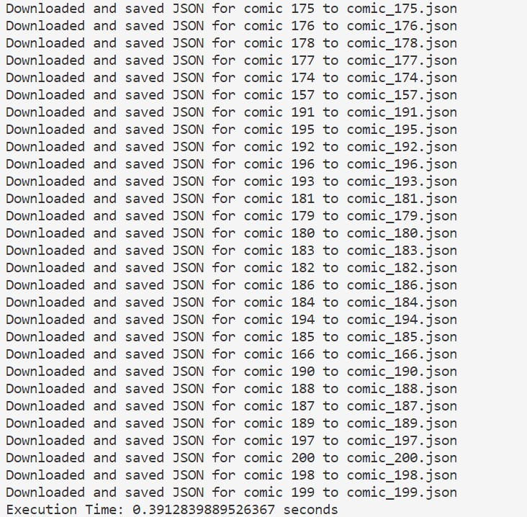
Sample Output:
…
Async Await in Python
Task - 3

Slide 66
Comparing the time of execution:
Task – 2: 88.338 seconds
Task – 3: 0.391 seconds
Thus, by using asynchronous programming in Python,
the same task has been performed in a very
efficient manner.
Async Await in Python
Task - 3

Slide 67
By utilizing asyncio and aiohttp, the modified code is able to parallelize the downloading of files, resulting in faster execution time compared to the synchronous approach.
The execution time is recorded and displayed at the end, providing insight into the overall time taken for downloading and saving all the JSON files.
Async Await in Python
Task - 3

Slide 68
Thank You
KOSS IIT Kharagpur

